Slide 1


Study and work research Puerto Rico
Team Rocket
Contributors
JANIN Rémi
DIALLO Elhaj Mamadou Foula
PAJANY CARPIN CAOUNDIN Allan
January 24, 2020

Slide 2
Presentation
The game:
Society Game named Puerto Rico
2 to 5 players
7 roles : Settler, Builder, Mayor, Craftsman, Trader, Captain, Prospector
Differents plantations/goods
Productions, industrials and big buildings
Produce, export, sell and buy goods
Winner = Player with the most victory points
The project:
Creation, development and monitoring
Implement AI, evaluate performances between random bot and differents AI

Slide 3
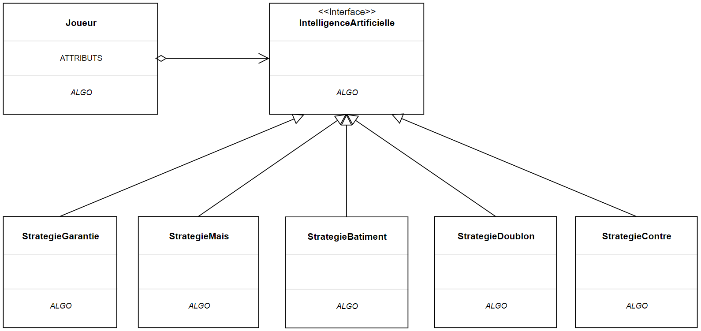
AI Guarantee
Implementation of the design pattern strategy

Slide 4
Strategy
No random choice (roles, plants, buildings…)
Earn victory points with the following configuration:
SETTLER -> BUILDER -> MAYOR -> CRAFTSMAN -> CAPTAIN
Plant, production building, colonist placement, produce and load goods on the boat

Slide 5
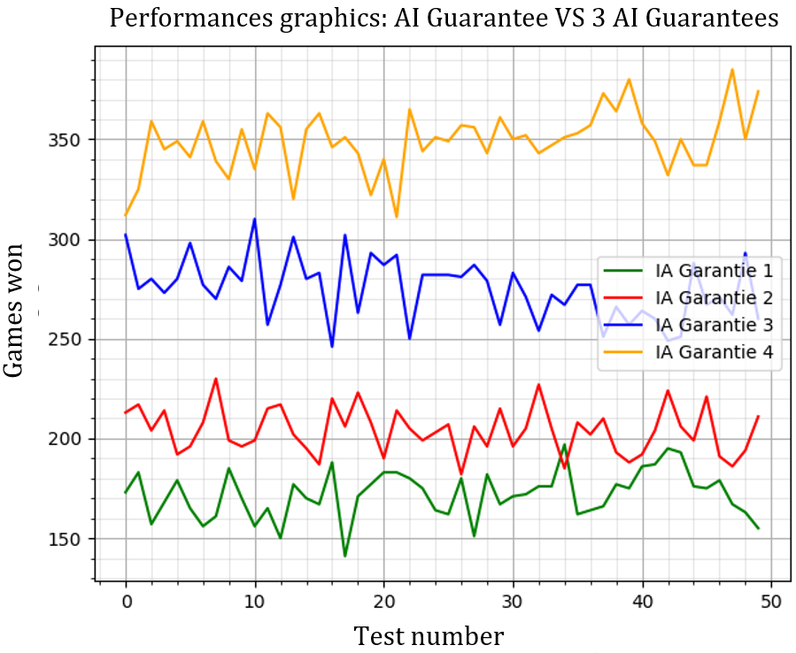
Performances
AI Guarantee VS Random: more than 99% (100% most of time)
AI Guarantee VS himself: The last AI wins most of the time (more than 51%)
Winning opportunity increases with position
Same strategy -> Final AI state quickly reached

Slide 6
AI Ambitious
Reorganization of the game motor
Observe the game and the players
Dynamic strategies:
Counter/Anticipation: Disadvantaging the opponent by forcing him to make random choices
Doubloons: Directing his choices towards obtaining doubloons quickly
SETTLER -> MAYOR -> CRAFTSMAN -> TRADER -> PROSPECTOR
Corn: Plant, produce and export only corn
SETTLER -> MAYOR -> CRAFTSMAN -> CAPTAIN
Buildings: Build as many buildings as possible in order to have more building victory points than your opponents
SETTLER -> MAYOR -> BUILDER

Slide 7
Performances
AI Ambitious VS Random: around 95%
AI Ambitious VS AI Guarantee : around 18%
Lack of robustness for changes in strategies
Strategies probably contains flaws
New strategies needed?
AI Ambitious VS himself: The 2nd AI wins generally (around 58%)
Like AI Guarantee VS himself performances

Slide 8
Difficulties encountered
Switching easily between differents AI
Changing the strategy of the ambitious AI
When should we change?

Slide 9
Summary
Satisfied
Enriching experience
Simplicity of the code
Possible improvement of AI Ambitious

Slide 10
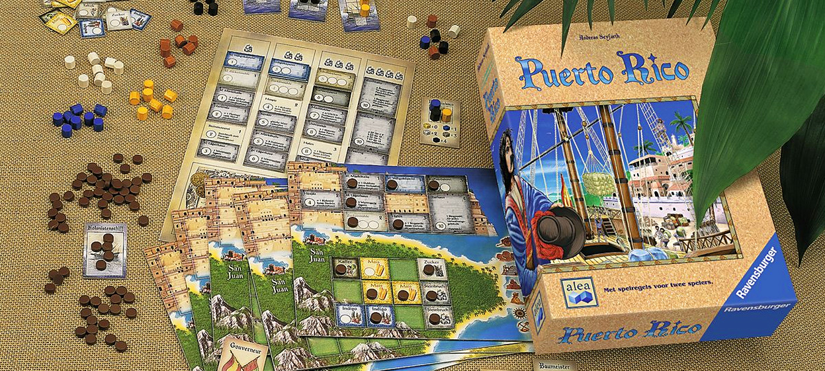
Thank you for your attention !!!

